Slide 1
THE STATE OF REGULATION
Dale J. Atkinson, Esq.
March 8, 2019
1:15pm – 3:00pm

Slide 2
Welcome and THANK YOU!!

Slide 3
Speaker
Dale J. Atkinson, Esq.
Atkinson & Atkinson, LLC
1466 Techny Road
Northbrook, IL 60062
847-714-0070
dale@atkinsonfirm.com

Slide 4
Agenda
Concepts
Application
Conclusion

Slide 5
Take Home Points
What are some take home points?
1.
2.
3 .

Slide 8
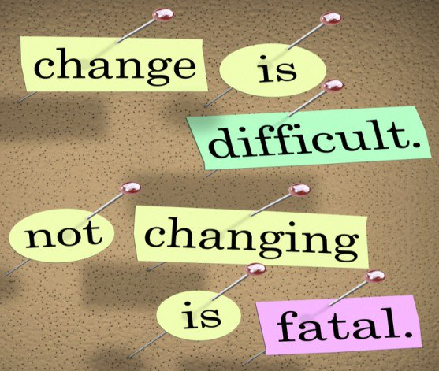
Regulatory Evolution

Slide 9
Change is Inevitable
What are the biggest challenges facing your boards/jurisdictions?

Slide 10
Are you prepared?
Biggest challenge: Lack of preparedness!?

Slide 11
How do we address these challenges?
Being informed
Trained
Knowledgeable
Understand role of board
Understand role of board member
Separate trade from regulation!

Slide 12
Change and evolution can come in many shapes and sizes…
Internally
Externally
Perception
Who knows what?

Slide 13
Regulatory Evolution
Embrace and Accept…
Perhaps the regulatory community does not spend enough time reflecting on basic concepts…
…and too much time defending the status quo.

Slide 14
Is regulation doing what it’s supposed to be doing?
How do we know?
How is it measured?
Can regulators be trusted?

Slide 15
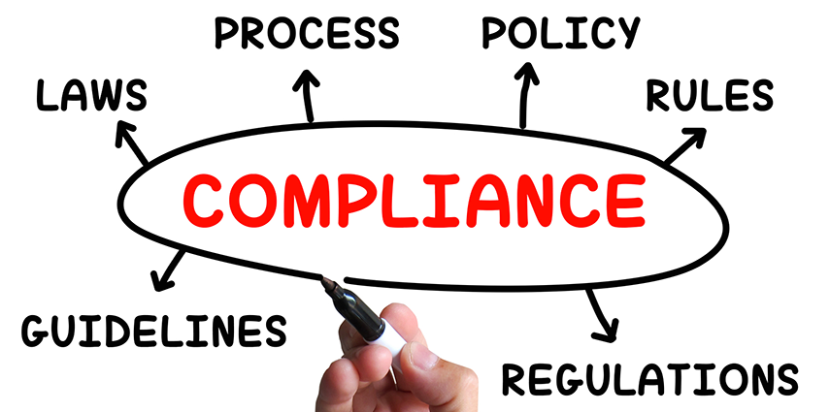
Ask….
Is the profession self-regulated?

Slide 16
Is the Profession Self-Regulated?

Slide 17
What separates government regulation from private sector?

Slide 18
What separates government regulation from private sector?
Mandates, societal benefits,
uniform application to all,
legal recourse with due process

Slide 19
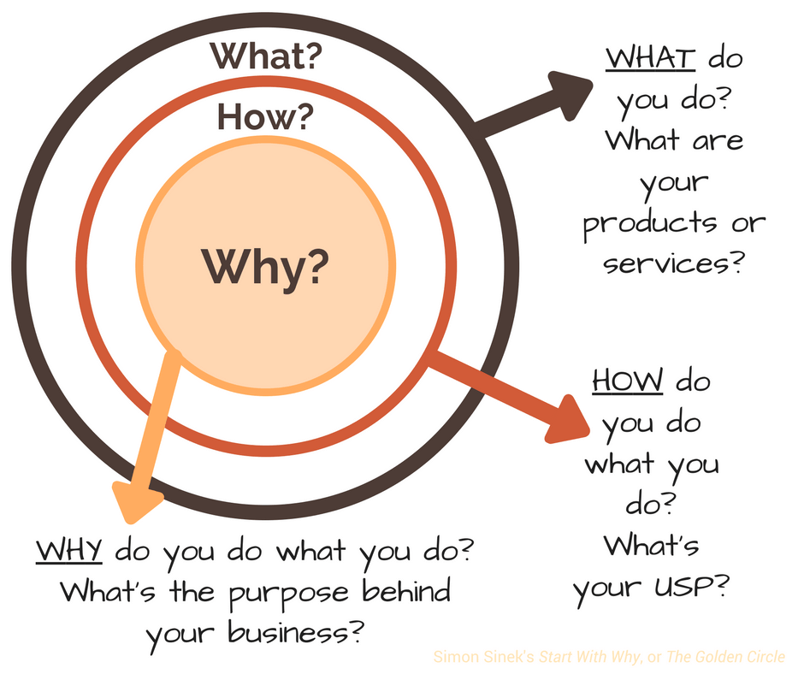
Take a few minutes:
Write down at least
five reasons why
government is
involved in regulation

Slide 20
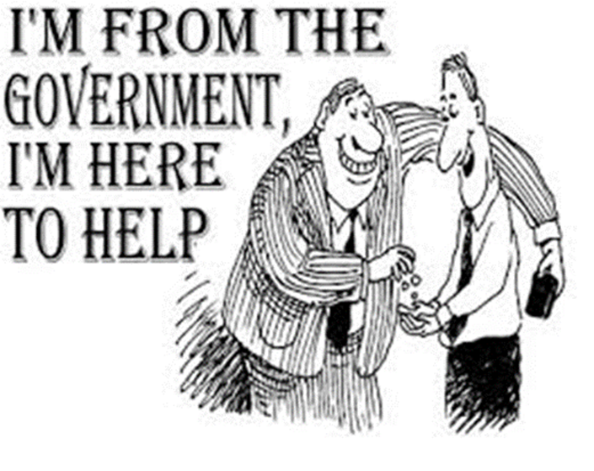
Why is Government involved in Regulation?
Public/consumer protection
Only authority that can mandate
Fairness
Sets standards in law
Due process, again only authority that can mandate fairness
Uniformity
Enforcement authority
All consumers benefit
All public benefit
Efficiencies of decision making
More…………………

Slide 21
Why?
Why is there government regulation?
…to protect society where they are unable to otherwise protect themselves

Slide 22
Why?
…through government, occupational/professional regulation provides consumers with an assurance of the qualifications of licensees along with a means of enforcement for the benefit of the public.

Slide 23
GOVERNMENT IS THE ULTIMATE EQUALIZER
WHY is government
the ultimate
equalizer??

Slide 24
Application of law
Enforce
Government creates rules that everyone must comply with………
Renewal
Constitution
Due process
Equal protection
Rules/regulations
Statutes
Equal rights
Issue license
Fairness

Slide 25
Tennessee Board of Architectural and Engineer Examiners
Mission:
The mission of the Tennessee Board of Architectural and Engineering Examiners is to protect the public health, safety and welfare through the regulation of architecture, engineering, landscape architecture and interior design, by means of evaluation, education, examination, licensure and disciplinary action; and to communicate with its registrants and the public regarding the laws and standards of the professions.

Slide 26
Why are there Criminal, Civil, & Administrative Processes
What are the commonalities and differences between….
Criminal;
Civil; and
Administrative proceedings

Slide 27
What do state boards do?

Slide 28
What do state boards do?
Carry out intent of the legislation
Meet as a board
Promulgate rules/regulations
Engage in public awareness
Account to legislature
License
Renew
Enforce
Investigate
Adhere to law, open meetings, transparency
More………………

Slide 29
Why are Licensees Appointed to Regulatory Boards?

Slide 30
Why are Licensees Appointed to Regulatory Boards?
Expertise
Efficiencies
Balance of opinions
Licensed and, thus, subject to codes/ethics

Slide 31
Are regulatory boards doing what they are supposed to be doing?
Speak up…
Why do you arrive
at this conclusion?

Slide 32
How?

Slide 33
How………Elevator Speech
Elements of your elevator speech….
Created by statute
Standards set forth in law (law includes statutes AND rules/regs)
Delegated with authority to enforce
Oversight
Authorized to promulgate rules/regulations
Protect the public
WRITE YOUR ELEVATOR SPEECH IN 113 WORDS OR LESS ……

Slide 34
Elevator Speech
The _____ board is statutorily created and delegated with the authority to regulate the ______ profession in the interest of protecting the health, safety, and welfare of the public. With necessary oversight by government, the board enforces standards and criteria set forth in statute and adds specificity through the promulgation of regulations. The effectiveness and efficiencies of the board is enhanced by populating the board with a combination of consumer members as well as those with the expertise necessary to address the complexities of profession specific issues. An administrative regulatory system provides consumers with an assurance of the qualifications of licensees along with a means of enforcement for the benefit of the public.

Slide 35
What?
What is government regulation?

Slide 36
What?
What is government regulation?
Legislative
Enacted statutes
Promulgated rules/regs
Force of law
Mandated
Standards and criteria
Government issued & renewed credential
Creates legal rights
Subject to enforcement
Transparency

Slide 37
Legal Landscape: Climate
Post-NCSBDE era
Legislation
Federal
State
Executive orders
Cases

Slide 38
Federal Legislation
Restoring Board Immunity Act (still in committee)
Professional Licensing Consortium – new LGAA
ALLOW Act (still in committee)
Veterans E-Health & Telemedicine Support Act
New HOPE Act (still in committee)
Concealed Carry Reciprocity Act (passed House, in Sen. committee)
Collateral Consequences Reduction Act Model Legislation
Right to Earn an Living Model Legislation
Notes:
As reminder…

Slide 39
Occupational Licensing Board Antitrust Damages Relief and Reform Act
HB 6515 would prohibit an individual from recovering damages against licensing board or its staff and members in anti-trust action if:
Enacted law for profession that needs to be regulated
New licenses – state must have sunrise review mechanism. Existing boards - periodic sunset review required unless occupation is licensed in at least 40 states
All members are appointed & include a public member
In Comm. on the Judiciary
Notes:
Govt. and indivs. can still sue for injunctive relief
Introduced July 2018

Slide 40
Protecting Jobs Act
HB 6156 aims to prohibit states from suspending, revoking, or denying state-issued professional licenses or issuing penalties due to student loan default.
Title IV or Health Education Assistance or Primary Care Loans
In House Comm. on Education and the Workforce
Notes:
Drivers licenses, teaching licenses, professional licenses
Introduced in June 2018

Slide 41
Michigan
MI HB 6110 passed in October, 2018 (in sen. Committee)
Boards could not consider past civil judgments or lawsuits as evidence of a lack of good moral character
Could not consider criminal conviction (alone) as conclusive evidence of lack of GMC unless a felony specifically listed as disqualifying offense & such would affect practice.
Provides procedures to contest findings
in Sen. Committee…
Notes:
Lawsuit in PA re: cosmetologists

Slide 42
Licensure Examinations – New York
Sept. 2018 Assembly Bill 11068 signed by Gov. requires funeral board to accept previously approved exam pass scores in perpetuity…
Licensees must be presumed to have successfully passed the licensure exam despite findings made about exam administrations after licensure
Exception: Comm’r determines after hearing that Practice Act was violated

Slide 43
Licensing Reform - Oklahoma
May, 2018: Ok SB 1475 - Occupational Licensing Review Act passed
Creates Occupational Licensing Advisory Commission to conduct review of each occupational or professional licensing act in no less than every 4 yrs and make recommendations to the Legislature.
New acts – reviewed within 90 days of enactment
Notes:
Fun fact re: commission makeup

Slide 44
Licensing Reform - Nebraska
April 2018: Occupational Board reform Act (LB 299) passed
2 step process to review regs:
“present, significant, and substantiated harms” that warrant regulation of profession
If so, regulation must be the “least restrictive” form that imposes lowest burden and costs
Applicants w/ criminal history can petition board re: eligibility prior to training & education

Slide 45
Licensing Reform - Wisconsin
WI bills being considered:
SB288: creates Occupational License Review Council - makes policy recommendations to legislature by 12/18 - FAILED
SB296: pathway for self-certification for certain occupations incl. dieticians, landscape architects, private detectives, sign language interpreters, etc. - FAILED
“License” includes the inclusion by the department of safety and professional services of an individual in the self-certification registry
“State-approved supporting organizations”
Notes:
* State determines that approving org. will benefit consumers, then org. approved and those indiv. Certified by that org can state that they are “state-certified”
Status: “available for scheduling”

Slide 46
Licensing Reform - Nevada
Jun 2018: Legislative Commission Sunset Committee recommended abolishing homeopathic board
40 practitioners would be under Div. of Public & Behavioral Health
Board was in debt - $145,000 to AG’s office
23 other boards under review survived
Notes:
Also AG not collecting fees from losing lawyers in contested cases

Slide 47
Licensing Reform – New Hampshire
HB 1818 would reduce penalties for certain individuals practicing without licenses or committing certain violations.
Barbering , cosmetology, court reporting without a license = “violation”, not misdemeanor or felony
Landscape architecture: unlicensed practice, impersonation of licensee, forging information to board = “violation”
Knowingly falsifying septic system plans = “violation”
in committee - study
Notes:
Also affects: athlete agents, real estate practice, auctioneers

Slide 48
Licensing Reform - Florida
Nov. 2018: Ballot measure to amend state constitution passed prohibiting state courts from deferring to an admin. agency’s interpretation of statute or rule.
Measure bundled with crime victims’ rights and judges’ mandatory retirement age increase.
Comm’n unique in U.S. and only meets every 20 years
Notes:
Marsy’s law
70 to 75
Commission meets every 20 years – only state with commission empowered to refer constitutional amendments to the ballot.

Slide 49
Physicians’ Rights at Hearing
LA Physician’s Bill of Rights (SB 286) would give licensees the right to confront their accusers and would exclude hearsay from hearings.
Complaints cannot be anonymous – chilling effect?
Board investigators may not communicate with board staff or members about investigation.
Limits board’s ability to summarily suspend a license.
Passed Senate; House Comm. on Health & Welfare – involuntarily deferred
Notes:
Back story

Slide 50
South Dakota Compact
Governor’s Bill – HB 1319 introduced in February
Grants 18 month temporary license (24 mos. for military spouses) to anyone with “valid, full, unrestricted license issued by a member state” and whose license is in “good standing” in every state where licensed.
License must be issued within 30 days of application
Result of reported consensus at Western Governors Association meeting and drafted with help from U.S. Dept. of Labor
Notes:
SD, CO, ND, MT, WY

Slide 51
More state actions…
Virginia HB 1566 – Creates a new agency: Division of Supervision of Regulatory Boards (failed to pass house)
Mississippi HB 1425 – Requires active supervision by the Governor of certain regulatory boards to provide antitrust immunity (passed)
Arizona SB 1437 Right to Earn a Living Act – restricts issuance of regulations which limit in the entry into a profession or trade, unless they can be shown necessary to the health and safety. Doesn’t address state oversight issue. (passed)

Slide 52
Perception is Reality

Slide 53
Contractors association, state board join forces to build new downtown office building (January 2017)
https://www.businessreport.com/article/contractors-association-state-board-join-forces-build-new-downtown-office-building (1/3/2017; last accessed 4/27/2017)
“Louisiana Associated General Contractors and the Louisiana State Licensing Board for Contractors are teaming up to develop a new four-story building in downtown Baton Rouge that will house offices for both entities.”
“The state LBC is funding the building, and we are providing the property,” says LAGC CEO Ken Naquin, who estimates the budget for the building’s construction at $6.5 million. “It’s a true public-private partnership.”

Slide 54
Contractors association, state board join forces to build new downtown office building (January 2017)
Some comments from readers posted to the article:
So, a lobbying organization and a state board are joining forces to construct a four-story (small) downtown building at the public's expense. What could go wrong with that?
Has this cleared the ethics commission? Can an entity that represents the regulated industry enter into an ongoing real estate transaction with the regulator (or the reverse it doesn't matter). When a contractor has a potential licensing problem and seeks assistance from the Louisiana Associated General Contractors Association will the transaction be "lets just go down the hall and see what our land lord/tenant (sic) has to say, you know we are very close?"

Slide 55
New downtown Baton Rouge office building put on hold amid cost concerns (June 2017)
https://www.businessreport.com/article/new-downtown-baton-rouge-office-building-put-hold-amid-cost-concerns (6/13/2017; last accessed 6/15/2017)
As originally planned, LAGC would donate the land – a vacant parcel adjacent to its existing downtown headquarters– and LSLBD was to develop the building, which the two organizations would share.
Three bids in an invitation-only process came in 50% higher than the $6.5 million budgeted.
Terms of the deal have changed – LAGC no longer a part of the project and sold the land to the LSLBC for $2.25 million.

Slide 56
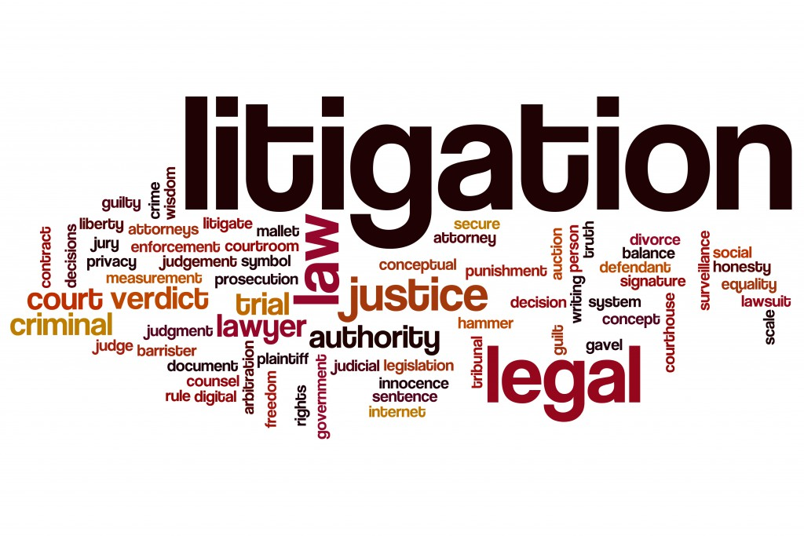
Recent Relevant Cases
Magnitude dude
30+ antitrust cases in the post NCSBDE SCOTUS decision era

Slide 57
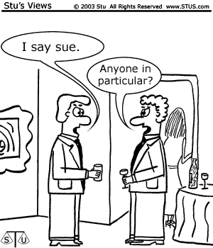
Keep Smiling…..
NARUTO, a Crested Macaque, by and through his Next Friends, People for the Ethical Treatment of Animals, Inc., Plaintiff-Appellant,
v.
DAVID JOHN SLATER; BLURB, INC., a Delaware corporation; WILDLIFE PERSONALITIES, LTD., a United Kingdom private limited company, Defendants-Appellees.

Slide 58
Naruto, the selfie taking
macaque , on appeal
or should I say on “a peel”

Slide 59
Let’s Stop Monkeying Around
PETA “failed” as a friend to Naruto, the court said. At one point the court even pondered whether Naruto might have sued PETA for its representation if he were a human.
“Puzzlingly, while representing to the world that ‘animals are not ours to eat, wear, experiment on, use for entertainment or abuse in any other way,’ PETA seems to employ Naruto as an unwitting pawn in its ideological goals,” the court wrote.

Slide 60
Composition: Physician Position
Bias v. Louisiana Physical Therapy Board,
2018 La. App. Unpub. LEXIS 345 *; 18 225, (App. Ct. 2018)
Physical therapist, licensed in both LA and TX
Anonymous complaint to LA Board; PT voluntarily ceased practice in LA
LA Board filed administrative complaint, hearing held, suspension of licensure with reinstatement conditions
Statute requires one PT Board member to be a physician, but such seat unfilled.
Court reversed Board action based upon non-compliance with statutory mandates
Court noted such cannot be waived…..

Slide 61
Sanction: Expired License by the Dozen
Coughlin v. Bureau of Profession & Occupational Affairs,
2019 Pa. Commw. Unpub. LEXIS 2, (Comm. CT. 2019)
Respondent certified and licensed as a CPA
Allowed license to “expire” (not renewed)
12 years after expiration, criminally convicted re: used car/consignment issues/fraud
Based upon criminal convictions, Board revoked his license and certificate and fined him $40K
Upheld by the court.

Slide 62
Unlicensed Practice: Home Value
Patel v. Zillow Inc. 2017 U.S Dist. LEXIS 134785, ( Dist. Ct. 2017)
Private suit vs. Zillow alleging damages caused by unlicensed practice of real estate appraising.
Plaintiff based lawsuit on cause of action under the practice act
U.S. District Court dismissed case
Illinois statute does not contain an explicit right
Rejected implicit right of action
Numerous remedies available to protect consumers

Slide 63
Speech v Unlicensed Practice
Jarlstrom v. Aldridge,
2018 U.S Dist. LEXIS 517427, ( Dist. Ct. 2018)
Argued First Amendment, freedom of speech
Cross motions for summary judgment
Court awarded Board motion re facial challenge to practice act
Court awarded Husband’s motion to all other aspects of litigation
Prohibition on use of “engineer” stricken from law
Permanent injunction in favor of husband granted

Slide 64
Speech v Unlicensed Practice
Jarlstrom v. Aldridge,
2018 U.S Dist. LEXIS 517427, ( Dist. Ct. 2018)
Husband (engineer in Sweden) researched red light cameras (wife received a ticket in the mail)
Submitted research conclusions to Oregon Board
Board, in turn, fined him for unlicensed practice of engineering and referring to himself as engineer
Husband sued board
Procedural history……….NEXT SLIDE

Slide 65
Jarlstrom v. Aldridge (OR 2017)
The United States District Court for the District of Oregon denied the Oregon State Board of Examiners for Engineering and Land Surveying Motion for entry of judgment in First Amendment case filed by person who was the subject of an administrative disciplinary action for the unlicensed practice of engineering. The Plaintiff undertook a traffic study related to red light cameras based upon his wife being issued a ticket. The Board found that the Plaintiff engaged in the unlicensed practice of engineering and fined him. Thereafter, the Plaintiff filed a lawsuit against the Board alleging the practice act violated his First Amendment rights both as applied and facially.

Slide 66
Jarlstrom v. Aldridge (OR 2017)
After some procedural wrangling, the Board admitted the application of the act to Plaintiff violated his First Amendment rights and moved for entry of judgment. The court referred to this filing as "procedurally unusual." The Board only sought entry of judgment as to the Plaintiff's allegation as applied to him, not facially. The court denied the Board motion finding that not enough information was available to the court to allow for a determination of whether the as applied application of the act would provide the Plaintiff with the fullest relief to which he may be entitled. Thus, the Board motion was denied.

Slide 67
Student Dismissal: Criminal Conviction
Goetz v. University of Bridgeport,
2018 Conn. Super. LEXIS 119, (Sup. Crt. 2018)
Connecticut education program terminated enrollment of student based upon criminal convictions (guilty plea; mail and wire fraud)
Student handbook and school policies noted crimes of moral turpitude or felonies constituted grounds for dismissal
Court upheld actions of the school finding that the student was adequately advised of consequences of criminal conviction

Slide 68
Conviction v Conduct
Moustafa v. Board of Registered Nursing,
2018 Cal. App. LEXIS 1135*, ( App. Ct. 2018)
Applicant for licensure as an RN, 4 convictions
Convictions; misdemeanors, later “dismissed”
Board denied licensure, Circuit court reversed, citing Business Code which bars boards from denying licensure solely on basis of conviction that has been dismissed
Court of appeals reversed finding that the board can rely upon “conduct” as a basis for denials
NOTE: in 2020, new CA legislation will prohibit reliance on conduct

Slide 69
Schultz v. Delaware Board of Architects (2018)
A Superior Court in Delaware affirmed the Board of Architecture's Letter of Reprimand and fine imposed on a licensee who failed to complete required CE hours. The licensee argued that because his failure was a miscalculation and not intentional, he could not be disciplined. The Court disagreed, finding that intent was of no matter in statute and the Board's order was supported by substantial evidence.

Slide 70
Unlicensed Practice
OR Supreme Court determined
that undertaking planning and designing in contemplation of erecting a building in Oregon constitutes the practice and is subject to regulation by the Board.
Referencing on company website “licensed in the State of Oregon (pending)” when no such application had been filed, was misleading to the public and violated the practice act prohibition from using the term architect or other related term(s).
Commercial speech is subject to regulation and that false and misleading speech can be regulated.
Twist Architecture & Design, Inc. v. OR Bd. of Architect Examiners (2017)

Slide 71
Twist Architecture & Design, Inc. v. OR Bd. of Architect Examiners (2017)
The Oregon Supreme Court reversed the court of appeals and upheld the Board order finding that the respondent engaged in the unlicensed practice of architecture and unlawfully represented themselves as architects. The court engaged in a thorough analysis of the scope of practice and found that undertaking planning and designing in contemplation of erecting a building in Oregon constitutes the practice and is subject to regulation by the Board. Such is true even if a building is not ultimately erected. The court also held that referencing on the website “licensed in the State of Oregon (pending)” when no such application had been filed and based upon the amount of time that had expired since the development of the website, was misleading to the public and violated the practice act prohibition from using the term architect or other related term(s). Indeed, one of the employees of the respondents was not licensed in any jurisdiction. Finally, the court rejected constitutional arguments propounded by the respondents. It held that regulation of the profession protects the health, safety, and welfare of the public and is a valid exercise of the state’s authority. Further free speech arguments were also rejected as the court held that commercial speech is subject to regulation and that false and misleading speech can be regulated.

Slide 72
What Constitutes Practice
Board suspended a landscape architect license for one year and issued a $250 fine for various findings of misconduct (misappropriation of client payments).
AL Supreme Court: misconduct occurred only within the context of the employer-employee relationship at the business in which the landscape architect worked.
Statute: qualifying language “in the practice of landscape architecture”
The Board was given no deference on its interpretations of its statutes, including its practice act and disciplinary grounds.
Ala. Bd. of Examiners of Landscape Architects v. Bostick (2016)

Slide 73
Ala. Bd. of Examiners of Landscape Architects v. Bostick (2016) (1 of 2)
The Alabama Supreme Court reversed the Court of Appeals thus throwing out the Alabama Board of Examiners of Landscape Architect’s disciplinary action against a landscape architect because the misconduct at issue did not fall within “the practice of landscape architecture.” The Board had suspended the license for one year and issued a $250 fine for various misconduct. The Supreme Court ruled that the misconduct occurred only within the context of the employer-employee relationship at the business in which the landscape architect worked. The landscape architect had misappropriated client payments into his own account by not depositing them into the business account of his employer where he worked as a landscape architect. The three checks totaled $2,196.90. The Board held these actions constituted “fraud or deceit,” “negligence or willful misconduct,” and “conduct involving fraud or wanton disregard of the rights of others."

Slide 74
Bostick, cont.
The Supreme Court ruled that because the first two violations of law were prefaced with the qualifying language “in the practice of landscape architecture,” no violation of law occurred as the misappropriation of client monies happened entirely within the employer-employee relationship. A relevant part of this definition was “the performance of professional services” where the financial wrongdoing happened in a business context after all professional services were rendered. As to the latter violation, the record showed no evidence any client was harmed by the failure to deposit monies to the employer. The quality of the services was good, and all services for which clients paid were actually performed. Applicable criminal and civil laws otherwise provided sufficient public protection. The Board was given no deference on its interpretations of its statutes, including its practice act and disciplinary grounds. Two justices dissented.

Slide 75
Non-Compliance with Probation
Board placed architect’s license on probation because he failed to notify it on his renewal application that his professional license in Nevada had been subject to discipline.
Probation violation complaint based on deficiencies in two plans – new 3 year probation.
Court held the Board relied on substantial evidence in concluding that the licensee exceeded the scope of "incidental" engineering.
Court held that he could be liable for another's violation of the practice act because he set his seal on a building plan, coordinated the work of others, and sought an engineer to seal the plans. By not ensuring that the engineer's title block was complete, he enabled the engineer to violate the law, thereby breaching the public's trust and confidence.
Curtis v. MO Bd for Architects, Professional Engineers, Professional Land Surveyors & Professional Landscape Architects (2017)

Slide 76
Curtis v. MO Bd for Architects, Professional Engineers, Professional Land Surveyors & Professional Landscape Architects (2017) (1 of 2)
A Missouri Court of Appeals affirmed the state Board of Architects, Professional Engineers, Professional Land Surveyors, and Professional Landscape Architects (Board) order placing an architect’s license on a three year probation for violations of a previous probation order. In 2014, the Board placed the license on probation because the plaintiff failed to notify it on his renewal application that his professional license in Nevada had been subject to discipline. Subsequently, the Board filed a probation violation complaint based on deficiencies in two plans submitted to the Board for review (as required under the terms of probation). The Board placed the license on probation for an additional 3 year term, affirmed by the lower court.

Slide 77
Curtis, cont.
On appeal, the plaintiff argued that he was not practicing engineering without a license because any engineering work incorporated into a plan was incidental to the architecture work, and that he should not be sanctioned for another person's violations on the other plan at issue. The court held that the Board relied on substantial evidence in concluding that the licensee exceeded the scope of "incidental" engineering and that he could in fact be liable for another's violation. He set his seal on a building plan, coordinated the work of others, and sought an engineer to seal the plans. By not ensuring that the engineer's title block was complete, he enabled the engineer to violate the law, thereby breaching the public's trust and confidence. The probation was upheld.

Slide 78
State Oversight: AG Office
Plaintiff wanted to be architect but didn't meet the licensing requirements.
Filed suit pro se, noting numerous perceived deficiencies in the state licensing structure for architects and claiming that the AG’s office and its executives harmed him through their inaction and failure to define "minimum competency".
U.S. Court of Appeals found that complaint was seriously deficient and lawsuit was frivolous.
Sturgell v. Coffman (10th Cir. 2017)

Slide 79
Sturgell v. Coffman (2017)
The U.S. Court of Appeals for the Tenth Circuit affirmed the lower court and dismissed the plaintiff's suit alleging that the state Attorney General's office and several of its officials failed to properly oversee the Board of Architects. The plaintiff desired to be licensed as an architect but didn't meet the licensing requirements. He filed suit pro se, noting numerous perceived deficiencies in the state licensing structure for architects and claiming that the defendants harmed him through their inaction and failure to define "minimum competency". The lower court allowed him to amend his complaint's many deficiencies in form and substance but ultimately dismissed it as frivolous. On appeal, the court found that his arguments lacked merit and that he did not address the complaint's deficiencies.

Slide 80
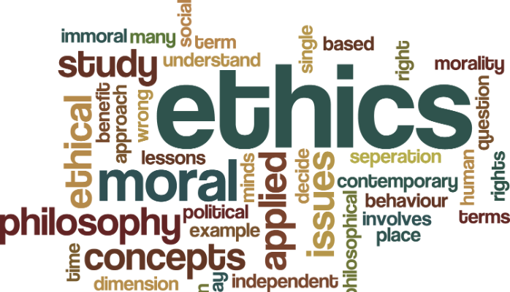
Why are there codes of conduct?
Speak up…

Slide 81
Terminology
Code of Conduct
Code of Ethics
What’s the difference?

Slide 82
State Ethics Commissions: Purpose
Establish public policy and standards of conduct
Ensure integrity and impartiality of government
Ensure government free of conflicts of interest
Applicable to regulatory boards

Slide 83
Ethics Commissions: General functions
Interpret and enforce relevant ethics laws
Investigate and adjudicate complaints
Provide outreach and education to public officers
Hint: TRAINING…an ounce of prevention
Accept and monitor public filings of certain officers

Slide 84
Ethics Commissions: General functions

Slide 85
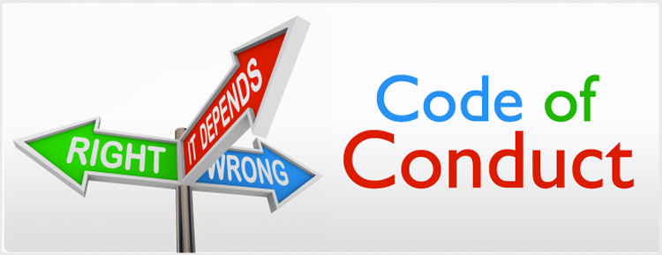
What is a Code of Conduct?
Thoughts?
Elements?
Enforceable?

Slide 86
Code of Conduct Applicable to the Profession?
Do we care?
Does such a code apply to persons serving on the Board of Architects, Landscape Architects, Surveyors, Engineers, etc.
Why?
Why not?

Slide 87
FARB Model Code of Conduct -previous
Personal Qualities
Board Decisions and Actions
External Activities and Relationships
Accountability

Slide 88
Current FARB Model
Statement of Purpose:
The purpose of this part is to set forth a code of ethics particular to members serving on professional and occupational regulatory boards, commissions, or councils. It is necessary to clearly define expected character and conduct of such individuals and establish a standard for removal from serving in order to sustain public confidence in the ability of a regulatory board to carry out its mission to protect the public health, safety, and welfare through the regulation of professions and occupations in the state of [INSERT].

Slide 89
Current FARB Model - Outline
Definitions
Conflict of Interest – ethics
Executive branch appointee
Prohibited associations
Board and staff relationships
Disclosure of board information
Personal performance of duties – practice
Conflict with other laws - enforcement

Slide 90
State Board Opportunities
Trained board members
Communication
With board members
With other boards
With legislature
Public protection
NCARB

Slide 91
Key Take Home Points
What are your take home points?

Slide 92
Key Take Home Points
Be informed
Be prepared
Seize the opportunities
The status quo may need to change
State’s rights

Slide 93
Thank You!!!!!

